Slide 1
CSE231 – Digital Logic Design
Karnaugh Maps
and
Minimization of Boolean Expressions

Slide 2
Karnaugh Maps
Graphical representation of a truth table
  Can be used to minimize logic functions
Uses Logic Adjacency
  A.B + A.B' = A (Boolean Algebra Law)
Does not produce unique results
Not directly transferable to computer algorithms
Why not just use Boolean Algebra?
  Boolean algebra is useful for general proofs
  Difficult to use for minimization

Slide 3
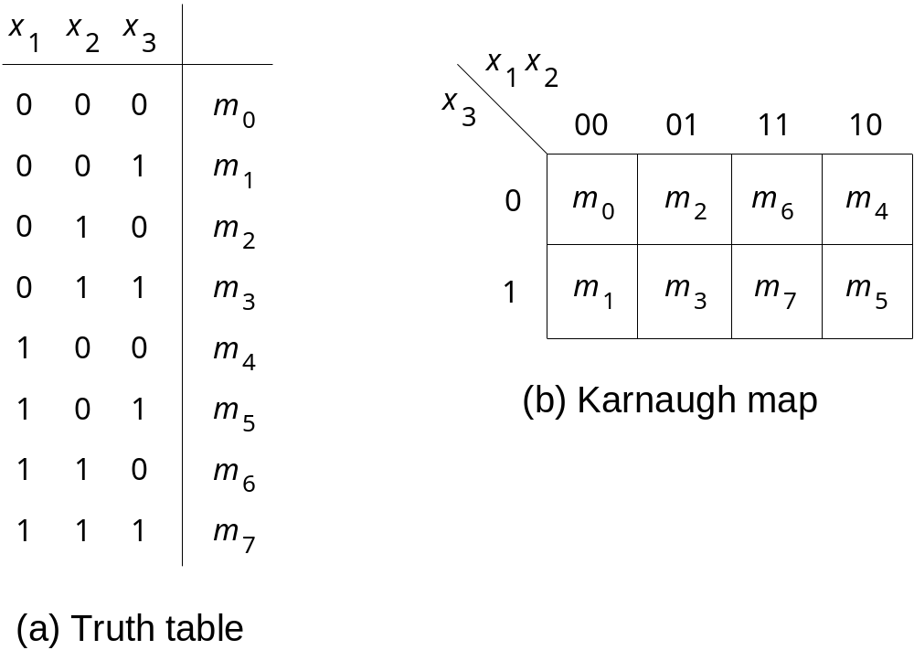
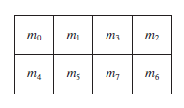
Three-variable K-Map
row #
x y z
Gray code
x y
0
1
2
3
4
5
6
7
z
LSB
y z
x

Slide 4
1
1
1
1
1
1
1
Q=A’C+AC=C(A+A’)=C
1

Slide 5
F(A,B,C)=L(0,1,2,4,6)
1
1
1
1
1
1
1
1
1
1
Q=X1’X2’+X3’
Q=x1’x3’+x1x3’+X1’X2’
=X3’(X1+X1’)+X1’X2’
=X3’+X1’X2’

Slide 6
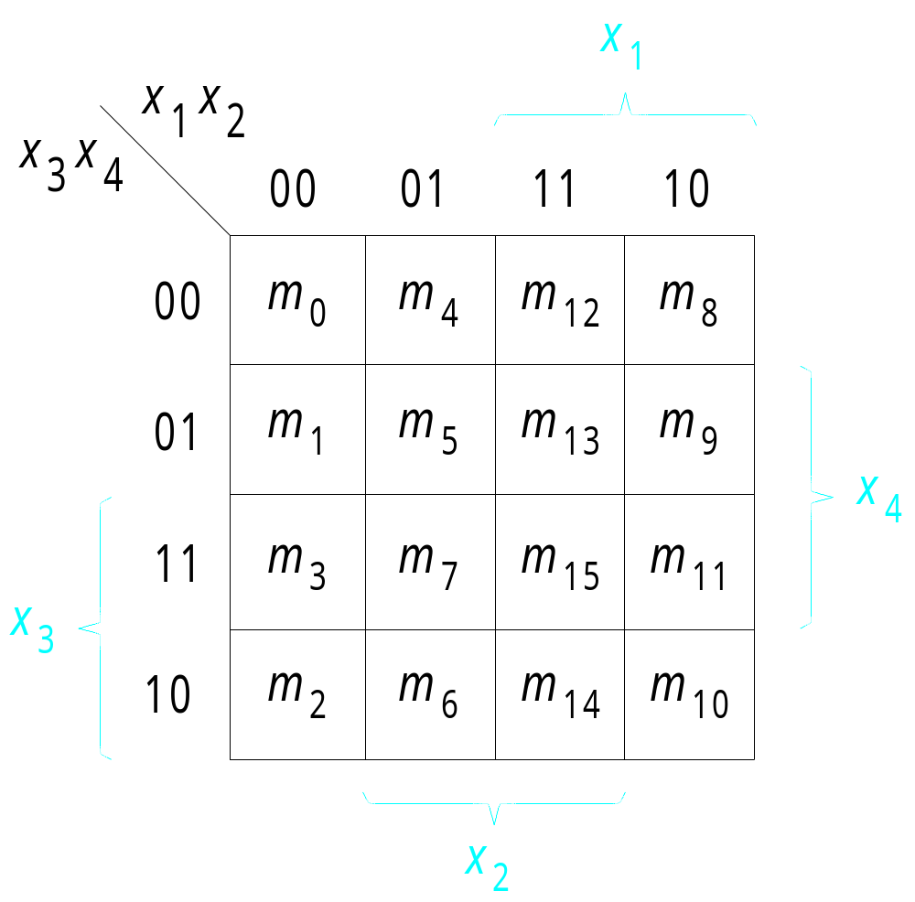
Four-variable K-Map
Gray code
Gray code

Slide 7
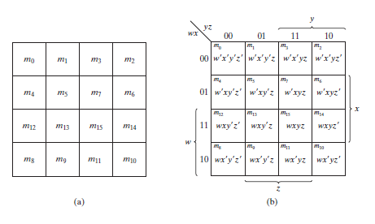
Four-variable K-Map

Slide 8
Minimization using K-Maps
(Deriving a SOP expression using minterms)

Slide 9
Minimization using K-maps
Enter minterms (for SOP) into K-map
Identify adjacent cells
  Minterms differ in only one bit
Use adjacency to minimize logic function
  Gray code used for enumeration
    Specifies the location of each minterm in K-map
  Horizontal and Vertical adjacency
    Both are logically adjacent
  K-map wraps
    Left and right columns are logically adjacent
    Top and bottom rows are logically adjacent

Slide 10
Minimization using K-Maps
Group adjacent cells to reduce
  the number of literals in a term
  the number of terms in a Boolean expression
Adjacencies are of size 1, 2, 4, 8, …
  Number of adjacent cells is a power of 2
  Adjacent cells form a rectangle
The larger the grouping of adjacent cells the greater the minimization of the logical function.

Slide 11
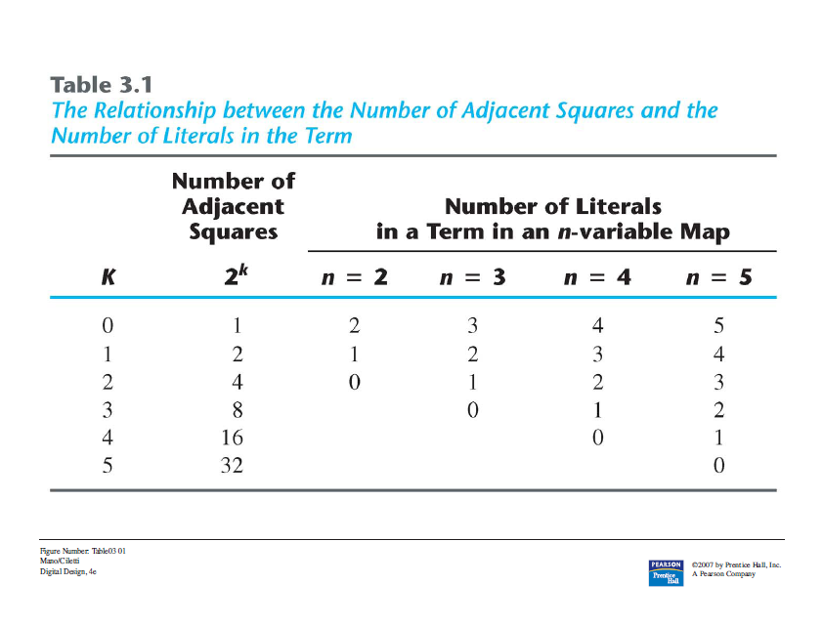
Minimization using K-Maps

Slide 12
Two-variable K-Map
Example:
Using a Karnaugh Map, minimize the logic function described by the following Truth table.

Slide 13
Two-variable K-Map
# | A | B | F
0 | 0 | 0 | 1
1 | 0 | 1 | 1
2 | 1 | 0 | 0
3 | 1 | 1 | 1

Slide 14
Three-variable K-Map
Example:
Using a Karnaugh Map, minimize the logic function described by the following Truth table.

Slide 15
Three-variable K-Map
# | A | B | C | F
0 | 0 | 0 | 0 | 0
1 | 0 | 0 | 1 | 1
2 | 0 | 1 | 0 | 0
3 | 0 | 1 | 1 | 0
4 | 1 | 0 | 0 | 1
5 | 1 | 0 | 1 | 1
6 | 1 | 1 | 0 | 1
7 | 1 | 1 | 1 | 0

Slide 16
Minimization using K-Maps
Exercise:
Given the following Truth table,
1. Derive the Boolean Expression
2. Use a K-Map to determine the minimized Boolean Expression

Slide 17
Minimization using K-Maps
# | A | B | C | F
0 | 0 | 0 | 0 | 1
1 | 0 | 0 | 1 | 0
2 | 0 | 1 | 0 | 1
3 | 0 | 1 | 1 | 0
4 | 1 | 0 | 0 | 1
5 | 1 | 0 | 1 | 1
6 | 1 | 1 | 0 | 1
7 | 1 | 1 | 1 | 0

Slide 18
Four-variable K-Map
Example:
Using a Karnaugh Map, minimize the logic function described by the following Truth table.

Slide 19
Four-variable K-Map
# | A | B | C | D | F
0 | 0 | 0 | 0 | 0 | 0
1 | 0 | 0 | 0 | 1 | 0
2 | 0 | 0 | 1 | 0 | 1
3 | 0 | 0 | 1 | 1 | 1
4 | 0 | 1 | 0 | 0 | 0
5 | 0 | 1 | 0 | 1 | 0
6 | 0 | 1 | 1 | 0 | 0
7 | 0 | 1 | 1 | 1 | 0
8 | 1 | 0 | 0 | 0 | 0
9 | 1 | 0 | 0 | 1 | 1
10 | 1 | 0 | 1 | 0 | 1
11 | 1 | 0 | 1 | 1 | 1
12 | 1 | 1 | 0 | 0 | 0
13 | 1 | 1 | 0 | 1 | 1
14 | 1 | 1 | 1 | 0 | 0
15 | 1 | 1 | 1 | 1 | 0

Slide 20
Four-variable K-Map
Example:
Using a Karnaugh Map, minimize the logic function described by the following Truth table.

Slide 21
Four-variable K-Map
# | A | B | C | D | F
0 | 0 | 0 | 0 | 0 | 0
1 | 0 | 0 | 0 | 1 | 0
2 | 0 | 0 | 1 | 0 | 1
3 | 0 | 0 | 1 | 1 | 1
4 | 0 | 1 | 0 | 0 | 0
5 | 0 | 1 | 0 | 1 | 0
6 | 0 | 1 | 1 | 0 | 1
7 | 0 | 1 | 1 | 1 | 1
8 | 1 | 0 | 0 | 0 | 0
9 | 1 | 0 | 0 | 1 | 1
10 | 1 | 0 | 1 | 0 | 1
11 | 1 | 0 | 1 | 1 | 1
12 | 1 | 1 | 0 | 0 | 0
13 | 1 | 1 | 0 | 1 | 1
14 | 1 | 1 | 1 | 0 | 1
15 | 1 | 1 | 1 | 1 | 1
AB
CD
00//A’B’
01//A’B
11//AB
10//AB’
00
 |  | 1 | 1
1 | 1 | 1 | 1
1 | 1 | 1 | 1
01
11
10
Q=C+AC’D=C+C’(AD)=C+AD

Slide 22
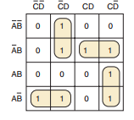
Q=A’C’D+A’BC+ACD’+AB’C’
Q= C’A’D+CA’B+ACD’+AB’C’
=C’(A’D+AB’)+C(A’B+AD’)

Slide 23
CD
AB
00//A’B’
01//A’B
11//AB
10//AB’
00
1 | 1 | 1 | 1
1 | 1 | 1 | 1
 |  |  | 1
1 | 1 | 1 | 1
01
11
10
Q=C’+ CD’+AB’=C’+D’+AB’

Slide 24
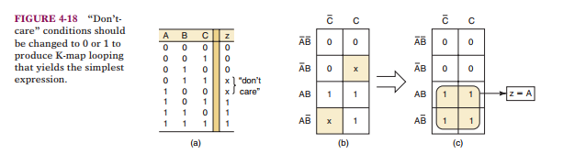

Slide 25

Q=AB’+AC’+A’B’
Q=AC’+A’B’
0

Slide 26


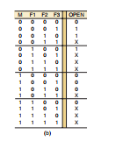

CD
AB
00//A’B’
01//A’B
11//AB
10//AB’
00
0 | 1 | 0 | 0
1 | 1 | X | 0
1 | 1 | X | X
1 | 1 | X | 0
01
11
10
Q=A’B+A’D+A’C

Slide 27
Minimization using K-Maps
Exercise:
Given the following Truth table,
1. Derive the Boolean Expression
2. Use a K-Map to determine the minimized Boolean Expression

Slide 28
Minimization using K-Maps
# | A | B | C | D | F
0 | 0 | 0 | 0 | 0 | 1
1 | 0 | 0 | 0 | 1 | 0
2 | 0 | 0 | 1 | 0 | 1
3 | 0 | 0 | 1 | 1 | 1
4 | 0 | 1 | 0 | 0 | 0
5 | 0 | 1 | 0 | 1 | 0
6 | 0 | 1 | 1 | 0 | 1
7 | 0 | 1 | 1 | 1 | 1
8 | 1 | 0 | 0 | 0 | 1
9 | 1 | 0 | 0 | 1 | 0
10 | 1 | 0 | 1 | 0 | 1
11 | 1 | 0 | 1 | 1 | 0
12 | 1 | 1 | 0 | 0 | 0
13 | 1 | 1 | 0 | 1 | 0
14 | 1 | 1 | 1 | 0 | 0
15 | 1 | 1 | 1 | 1 | 1

Slide 29
Minimization using K-Maps
(Deriving a POS Expression using the Maxterms)

Slide 30
Minimization using K-maps
Enter Maxterms (for POS) into K-map
Identify adjacent cells
  Maxterms differ in only one bit
Use adjacency to minimize logic function
  Gray code used for enumeration
    Specifies the location of each Maxterm in K-map
  Horizontal and Vertical adjacency
    Both are logically adjacent
  K-map wraps
    Left and right columns are logically adjacent
    Top and bottom rows are logically adjacent

Slide 31
Three-variable K-Map
Example:
Using a Karnaugh Map, minimize the logic function described by the following Truth table.

Slide 32
Three-variable K-Map
# | A | B | C | F
0 | 0 | 0 | 0 | 0
1 | 0 | 0 | 1 | 1
2 | 0 | 1 | 0 | 0
3 | 0 | 1 | 1 | 0
4 | 1 | 0 | 0 | 1
5 | 1 | 0 | 1 | 1
6 | 1 | 1 | 0 | 1
7 | 1 | 1 | 1 | 0

Slide 33
Four-variable K-Map
Example:
Using a Karnaugh Map, minimize the logic function described by the following Truth table.

Slide 34
Four-variable K-Map
# | A | B | C | D | F
0 | 0 | 0 | 0 | 0 | 0
1 | 0 | 0 | 0 | 1 | 0
2 | 0 | 0 | 1 | 0 | 1
3 | 0 | 0 | 1 | 1 | 1
4 | 0 | 1 | 0 | 0 | 0
5 | 0 | 1 | 0 | 1 | 0
6 | 0 | 1 | 1 | 0 | 1
7 | 0 | 1 | 1 | 1 | 1
8 | 1 | 0 | 0 | 0 | 0
9 | 1 | 0 | 0 | 1 | 1
10 | 1 | 0 | 1 | 0 | 1
11 | 1 | 0 | 1 | 1 | 1
12 | 1 | 1 | 0 | 0 | 0
13 | 1 | 1 | 0 | 1 | 1
14 | 1 | 1 | 1 | 0 | 1
15 | 1 | 1 | 1 | 1 | 1

